Slide 1
Rapid Antigen Screening Program
Comparison of rapid antigen testing modalities: BD VeritorTM and Abbott PanbioTM
Tuesday, February 16, 2021 (updated March 15)

Slide 2
Antigen tests
There are different types of antigen tests in scope (e.g. Panbio and BD Veritor)
The distribution of type of tests will be determined by many factors, including provincial supply
Sites will be told which test they are receiving, so they can ensure staff are properly trained
Antigen tests have the same:
Clinical guidance
Data reporting requirements
Staffing requirements
Quality best practices
Panbio and BD have very similar workflows, staffing requirements and equipment needs

Slide 3
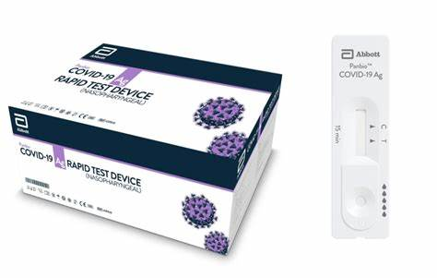
Antigen Rapid Testing Modalities
PanbioTM and BD VeritorTM are both used in the Provincial Antigen Screening Program
Primary difference entails use of analyzer to interpret results for BD VeritorTM
 | Abbot PanbioTM | BD VeritorTM
Type of Test | Antigen testing for asymptomatic screening
Swab Type | Nasopharyngeal, deep nasal, throat + nares, nasal | Deep nasal, throat + nares, nasal
Result TAT | 15-20 mins | 15 mins
Performance | Sensitivity >70%*^{, +}, Specificity >95%* | Sensitivity 84%*, Specificity 100*
Equipment | Tests | Tests and analyzer
*Manufacturer reported results
⁺ PHO has reported sensitivity ranging from 25-65% for asymptomatic use

Slide 4
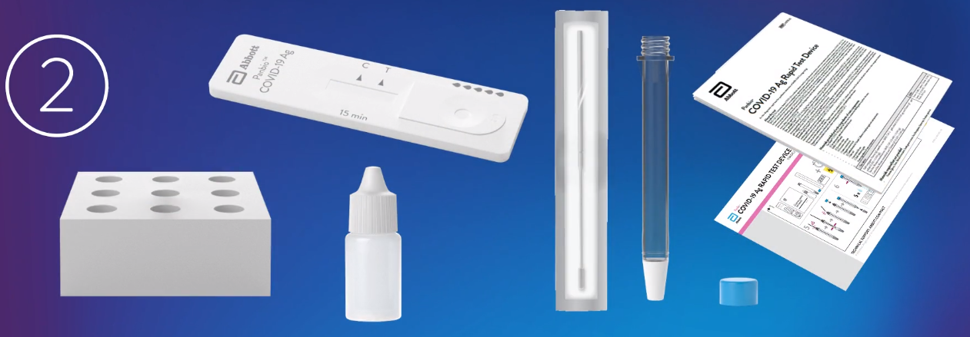
Panbio™ Kit
  25 Test devices with desiccant in individual foil pouch
  25 Extraction tubes
  25 Extraction tube caps
  25 Sterilized swabs* for specimen collection
  1 Buffer (1 x 9 ml/bottle)
  1 Positive control swab
  1 Negative control swab
  1 Tube rack
  1 Quick reference guide (Nasopharyngeal)
  1 Instructions for use
Test device
Tube rack
Buffer
NP swab
Instructions and quick reference guides
Extraction tube and cap

Slide 5
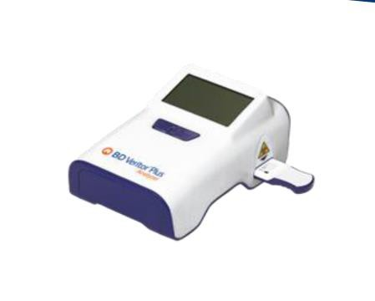
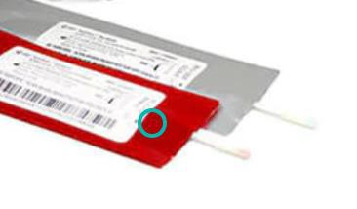
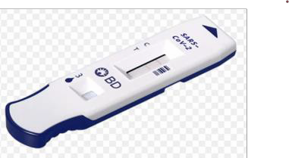
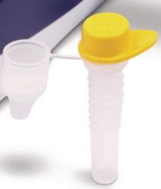
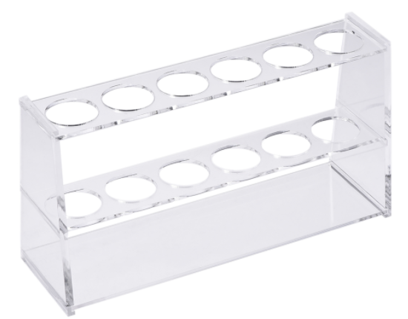
BD Veritor™ Analyzers + test kit
Analyzer
Analyzer: the BD Veritor™ device used to process the rapid test; includes a power adaptor (provided
Test kits:
30 single use test devices
30 single use reaction tubes, each with 325 µL extraction reagent and having an integral dispensing tip
30 sterile, single use specimen sampling nasal swabs
1 Positive control swab
1 Negative control swab
1 disposable test tube rack
Quick reference guides and manuals for use
Positive and negative controls
Test device
Extraction reagent
Swabs
Tube rack

Slide 6
Training and supporting documents
Documents | Test-specific or Test-agnostic
Onboarding guide | Separate documents for each testing modality
Specimen collection techniques | Applicable to all antigen testing modalities
Results tracker
Best practices for point-of-care testing
Webinar recordings | Test-specific or Test-agnostic
Introduction to Provincial Antigen Screening Program | Applicable to all antigen testing modalities
Best practices for point-of-care testing
Documenting and reporting results
Rapid antigen screening clinic operations and procedures | Separate documents for each testing modality

Slide 7
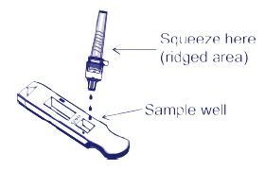


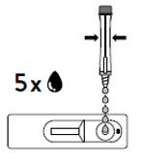
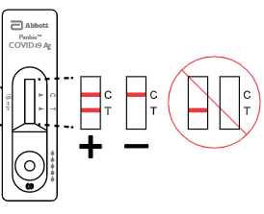
Testing Process Workflow
1. Preparations & intake
2. Collecting the specimen
3. Testing the specimen & recording results
4. Communicating results
BD VeritorTM
Pre-register participants
Collect and process specimen
Take tube with sample and dispense 3 drops in well of test cartridge, set timer for 15 mins, power on analyzer. After 15 mins, staff inserts cartridge into analyzer. Analyzer processes test and provides result; result recorded before cartridge is removed from analyzer. If batch testing, repeat step 3 for 10 specimens at a time.
Communicate results
1. Preparations & intake
2. Collecting the specimen
3. Testing the specimen
4. Interpreting
results
5. Recording results
6. Communicating results
Abbott PanbioTM
Prepare test kits in advance and register participants
Collect and processe specimen
Take tube with sample and dispense 5 drops in well of test cartridge, set timer for 15 mins.
After 15 mins, read test cartridge to interpret and record results. If batch testing, steps 3-5, are repeated for each batch at the same time.
Communicate results

Slide 8


Additional Considerations
Consideration | BD VeritorTM | PanbioTM
Batch testing | 10/batch | 5-10/batch
Testing rate | ~20 tests/hr | ~30 tests/hr
Power source req’d*
Staffing recommendation for volume testing | 3 persons (health professional or trained individual) | 2-3 persons (health professional or trained individual)
Collected specimen can be stored in extraction buffer before being tested | Up to 30 minutes | Up to 2 hours
Buffer preparation | No additional preparation needed | Minimal preparation of buffer required
*BD VeritorTM Analyzer can perform ~300 tests on single full charge. Depleted battery will re-charge in 7 hours.

Slide 9
Appendix

Slide 10
Clinical Guidance for Rapid Antigen Screening (1/2)
Ministry of Health guidance outlines the use of rapid antigen screening: COVID-19 Guidance: Considerations for Rapid Antigen Screening
  Consistent guidance for BD VeritorTM and PanbioTM
Rapid antigen tests should only be used for screening asymptomatic individuals at your facility
Screening is recommended 1-3 times weekly, depending on the prevalence of disease in the community
Rapid antigen tests are not for diagnosis of acute COVID-19 infection or for managing an outbreak at your facility
Individuals who have previously been infected with and recovered from COVID-19 should not undergo repeat testing/antigen screening, unless otherwise directed by local public health or their health care provider as per their symptom and exposure history.

Slide 11
Clinical Guidance for Rapid Antigen Screening (2/2)
Confirmatory Test for Positive Results:
  A positive result on a rapid antigen screening test is considered a preliminary positive and should be followed up with a laboratory-based PCR test to act as a confirmatory test, within 24 hours.
  Individual should be advised that they have a preliminary positive result and should immediately self-isolate.
  Local public health should be notified of the preliminary positive result.
Negative Results:
  This is a screening test result, and only applies if the individual tested has no symptoms and no known exposure to COVID-19.
  Individual should be told that the result is negative, and a false negative is possible.
  Individual should be directed to continue to follow infection prevention and control measures.

Slide 12





Key Site Requirements for BD VeritorTM and PanbioTM
Rapid testing lead:
An administrator, director of care or other lead to oversee the rapid testing implementation at your organization.
Testing personnel: Health professionals or trained individuals to perform the swabbing and operating the rapid testing device.
Confirmatory testing: The ability to collect PCR swabs or process in place to direct individuals with preliminary positive results from the rapid testing to closest assessment centre or participating community lab for confirmatory lab-based testing.
Ongoing quality support and capacity: Staff conducting the screening clinic should review the training session to ensure the antigen testing is run appropriately and the required quality checks are performed on the BD Veritor.
Data reporting: Sites are required to submit minimum data elements requested on a regular basis (e.g. weekly reporting of volumes).

