Slide 1

OHT Members’ Leaders: Meeting #2
October 15, 2020

Slide 2


Welcome!
Please begin by introducing yourselves:
Name
Organization
Role

Slide 3
Agenda
Time | Item
7:00 pm | Welcome | Joe Lee
7:10 | CDMA Essential Concepts | Ingrid Pregel and Ron Gagnon
8:00 | Discussion | All
9:00 pm | Adjourn | All

Slide 4
CDMA Essential Concepts

Slide 5
Members: Partners & Affiliates
All signatories will become members of the OHT (if they agree to sign the CDMA)
Membership is open to others to join at any time during the year if they agree to follow the requirements of members – approved by Partner members
Requirements of Members: All members agree:
  They wish to join and support an interconnected seamless set of health and wellness services for the benefit of 395,000 people in KW4
  They support the quadruple aim of the Ministry of Health
  They support the Design Framework and My Health and Wellness Journey in KW4
  They will receive information regularly and provide input to decisions through participation in working groups and active participation in meetings of Members
  They will freely offer information and advice on the various subjects that are put before the Members by the Steering Committee
  They will actively support the goals and objectives of the OHT as ambassadors in the community

Slide 6
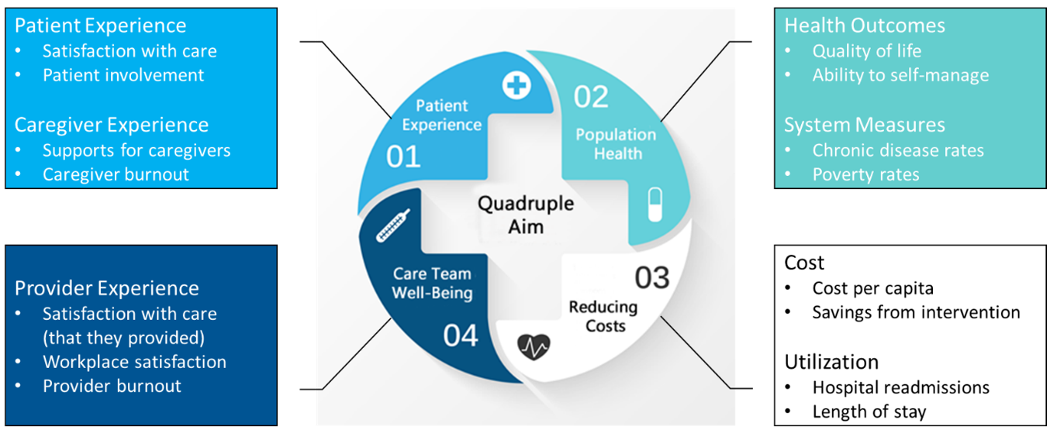
Recent Restructuring of our Health System
OHT: Overview and Goals
An Ontario Health Team is a group of providers that are clinically and fiscally accountable for delivering a full continuum of care to an attributed population within a specific geographic area.
Notes:
Let’s begin with the recent restructuring of our health system.
In February 2019, the Ontario Ministry of Health announced a plan to restructure the health system, involving the formation of a new central agency (Ontario Health) and Ontario Health Teams
The vision for OHTs as set out by the Ministry is to create integrated care systems in Ontario to improve health outcomes, patient and provider experience, and value (also known as the Quadruple Aim).
An OHT is a group of providers that are clinically and fiscally accountable for delivering a full continuum of care to an attributed population within a specific geographic area.

Slide 7

KW4 OHT In Development Design Framework V 12.0
We exist to support our community’s vision.
“A Community where everyone thrives, and no one is left behind” (Wellbeing Waterloo Region’s Community Aspiration)
Our team’s purpose: We enable collaborative health care relationships. All people are empowered to achieve health and well being.
We Promise:
We will be partners. Our team includes patients, families, caregivers and the community in partnership with health and social service providers
We will be inclusive. We work with diverse populations and urban and rural communities
We will pay attention to the social determinants of health. A focus on them begins in infancy to prevent illness and promote health
We will achieve excellence. We are nimble, courageous and innovative
We will value relationships. Our culture is built on empathy and trust
Notes:
To help guide the work of the KW4 OHT we undertook an exercise to develop what is most commonly referred to as an organization’s vision, mission and values.
This work took place over several months, involved lots of stakeholder consultation, and resulted in an iterative process of defining why we exist, what we want to achieve, and what is important to us in our journey.
We are currently on version 11 of this framework and although it is still draft we felt it was important to share with this group as we begin our work.
Wellbeing Waterloo Region already has a community aspiration that is “A community where everyone thrives, and no one is left behind. The KW4 OHT exists to support this community vision.
Our purpose is to enable collaborative health care relationships. All people are empowered to achieve health and wellbeing.
I will leave it to you to read our promise but will highlight some key themes including partnerships, inclusiveness, prevention, health promotion, excellence, nimbleness, courage, innovation, empathy and trust.

Slide 8
We are accountable to the Ministry of Health, through Ontario Health
The Ministry’s Intention for the Ontario Health Team model:
  Allow providers to deliver better, faster, more coordinated and patient-centred care to achieve improved health outcomes, patient and provider experience and value
  Full, coordinated continuum of care
  24/7 system navigation; care coordination supporting seamless transitions
  Performance outcomes on metrics supporting quadruple (quintuple?) aim
  Clear clinical and financial accountability framework
  Integrated funding envelope at maturity
  Reinvestment in front line care
  Digital first approach
We are more than only MOH/LHIN funded agencies, but as a collaborative we are accountable to MOH
Notes:
To help guide the work of the KW4 OHT we undertook an exercise to develop what is most commonly referred to as an organization’s vision, mission and values.
This work took place over several months, involved lots of stakeholder consultation, and resulted in an iterative process of defining why we exist, what we want to achieve, and what is important to us in our journey.
We are currently on version 11 of this framework and although it is still draft we felt it was important to share with this group as we begin our work.
Wellbeing Waterloo Region already has a community aspiration that is “A community where everyone thrives, and no one is left behind. The KW4 OHT exists to support this community vision.
Our purpose is to enable collaborative health care relationships. All people are empowered to achieve health and wellbeing.
I will leave it to you to read our promise but will highlight some key themes including partnerships, inclusiveness, prevention, health promotion, excellence, nimbleness, courage, innovation, empathy and trust.

Slide 9
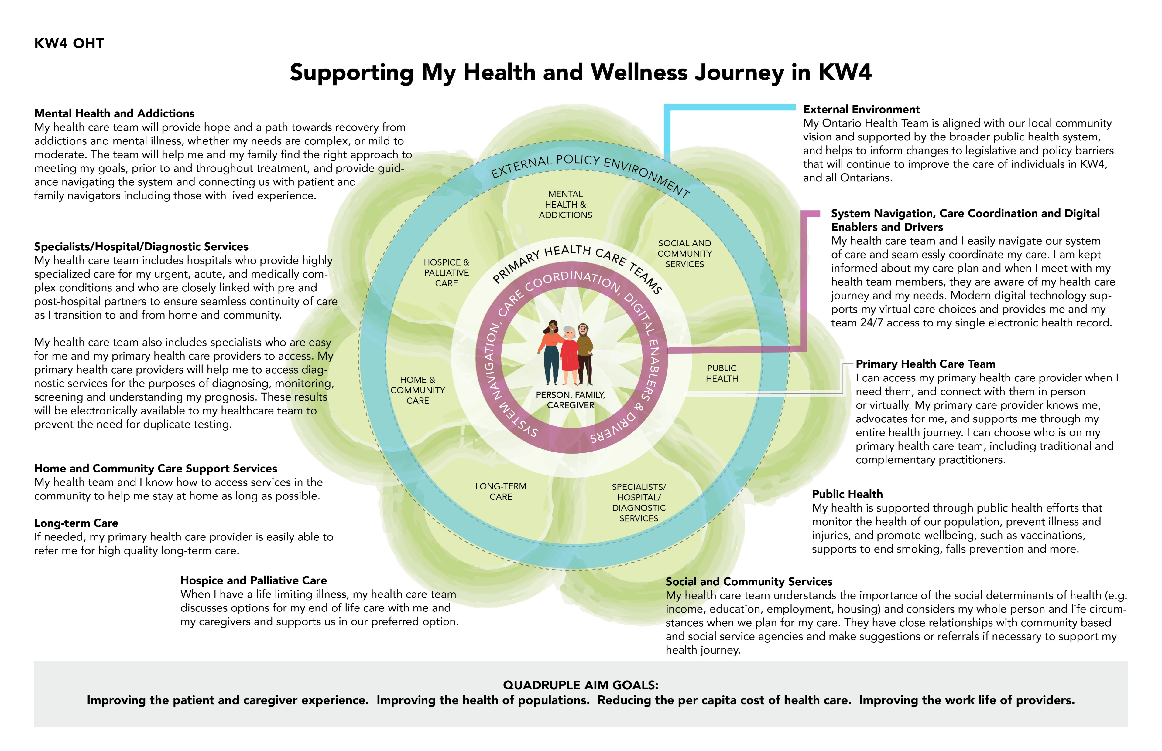
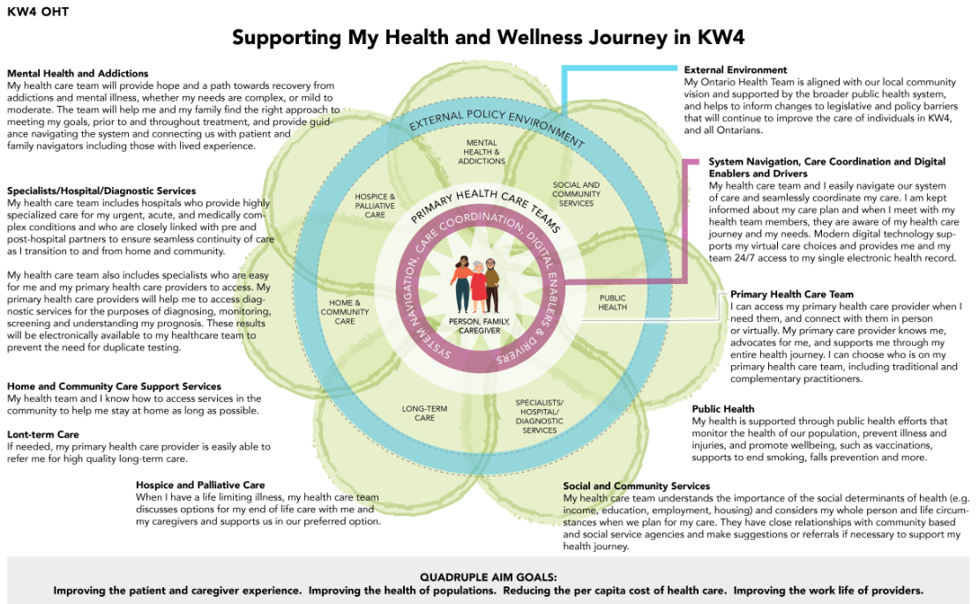
Notes:
In addition to developing our vision we also developed a pictorial of our design framework called Supporting My Health and Wellness Journey in KW4.
The goal is a health system for all 400,000 residents that offers seamless, interconnected care continuity across providers.
It is designed with patients and their families at the centre, surrounded by System Navigation, Care Coordination and Digital Enablers & Drivers to recognize the importance of patients and their health care team being able to easily navigate and seamlessly coordinate care and that modern digital technology supports a patients virtual care choices.
The next “ring” is Primary Health Care Team. Our vision is that patients will have the ability to choose who is on their primary care team, including traditional and complimentary practitioners.
The next layer are health system supports/providers that offer patients with 24/7 system navigation and the right services at the right time and in the right place to meet their needs. The shape is meant to illustrate the permeability of supports as opposed to hard boundaries.
And the outside ring ensures that we align with the community visions and the broader public health system legislation and policies
At the bottom we have included the quadruple aim goals as defined by the Ministry

Slide 10
Members: Partners & Affiliates
Some will also choose to become Partner Members:
  To actively collaborate with other partners working on specific projects and initiatives that will further the quadruple aim and the health and wellness care experience of specific populations
    Including providing the needed resources (financial, human, tools, systems etc) to do the necessary work, as agreed by approving the annual plans and budget
  To provide resources (financial perhaps in combination with some in kind) to enable the OHT to integrate and coordinate the agreed strategies, initiatives and priorities contained in the approved plans and budget each year (including COVID-19 preparedness and response in year one)
  To be held collectively accountable as partners to the MOH for clinical and fiscal outcomes
Partner Members are represented at meetings by the Executive Director/CEO

Slide 11
Members: Partners & Affiliates (cont’d)
Others choosing not to be Partner Members will be Affiliate Members, perhaps waiting to join as Partner Members when plans coincide with their own organization’s strategic priorities
All members will benefit from:
Opportunities to inform future plans for the OHT as it builds to maturity, including selecting new target populations and services
The chance to share resources with other agencies to create synergies and better care experiences for residents
Over time as the OHT receives funds and has a single funding envelope, the opportunity to share in that funding

Slide 12
Roles and Responsibilities
Partner Members make decisions, based on input from all Members, the Steering Committee, the Operations team and working groups of the KW4 OHT
Scope of such decision making includes OHT strategic plan, priority populations and services, annual budget and resource allocations
Members (Affiliates and Partners) meet together with the Steering Committee every 2 to 3 months or more frequently at the call of the Steering Committee Chair
New Members (Affiliate and Partner) are admitted by Partner Members according to criteria outlined in this agreement and a process created by the Steering Committee and approved by the Partner Members

Slide 13
Roles and Responsibilities
Shared Leadership
Continuity and renewal for Steering Committee
  Proposal: 3 year terms, maximum 2 renewals, staggered initial terms to begin the rotation
  Consider: requirement for 1 physician among the 5 service provider roles, including in kind Support Services organization on Steering Committee
Operations team renewed annually based on skill sets needed to support annual plan – transparent call out for in kind resource commitments
Annual plans comprise projects initiated, resourced and lead by partner members

Slide 14
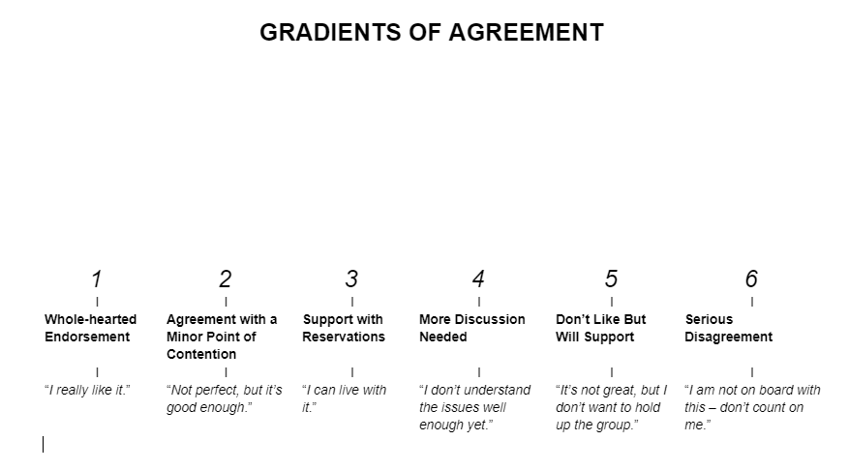
Roles and Responsibilities
Decision Method
All OHT organizational structures will use consensus as the preferred decision making process
By exception, some decisions may require a 2/3 majority vote

Slide 15
Information Sharing & Transparency
Key values: openness, transparency and timeliness
Members transparently provide information to one another in the spirit of “everything is shareable unless for legal reasons it cannot be”
Steering Committee reports OHT financial and performance information to all Members
ED/CEOs of Members are responsible to ensure their Boards of Directors and staff are regularly updated with respect to OHT plans, initiatives and progress and that the OHT is one of the top priorities in their organization’s strategic and/or operational plans
Steering Committee reports regularly to the community, physicians, other providers of health and wellness services, people receiving health and wellness services and their families and caregivers and to the MOH

Slide 16
Information Sharing and Transparency
Scope?
Financial, performance metrics and dashboard, progress against annual plans, projects and commitments and any other information that is important to being apprised of the progress on accountability for achieving first two years’ goals
Information that is relevant to current year one target populations as well as informing future planning
Obligation to share with fellow members both outcomes and the care pathways that achieve those outcomes to understand interconnections between members (the “how”)
Commitment to establishing a targeted communications and engagement strategy for the OHT that is reviewed annually

Slide 17
Information Sharing and Transparency
Respecting privacy requirements, and working across OHT partners to problem solve privacy issues that serve as barriers to improving care experience
  Members will share personal health information with one another for the purposes of providing health services, and coordinating its provision, in accordance with applicable laws
  Members will enter into a data sharing agreement in respect to sharing personal health information
Confidentiality
  Members, Steering Committee members, Operations Team members and Working Group members sign a privacy and confidentiality agreement

Slide 18
Identifying and Measuring Impacts on
Priority Populations
OHT will have a data architecture that:
Enables population health management, quality improvement and outcomes measurement
Links measures to the Quadruple Aim
Tracks progress against provincial and local targets and benchmarks
Supports developing logic maps linking activities and outcomes
Drives an overarching Balanced Scorecard and cascading dashboards for monitoring and reporting
The Steering Committee:
Identifies and measures the priority populations for the KW4 OHT and the impact of decisions on them
Consults with, informs, and provides recommendations to Partner and Affiliate Members at Member meetings

Slide 19
Expansion to More Populations, Services and Providers
The Steering Committee:
Establishes and monitors progress towards an overall strategic plan and annual work plan
Provides a forum for Partner and Affiliate Members to provide input and offer business cases for expansion consideration
Ensures decisions regarding expansion:
  Align with KW4 OHT My Health and Wellness Journey in KW4
  Are informed by qualitative and quantitative evidence including equity considerations
  Consider OHT capacity to execute
  Will not negatively impact sustainability of improvements for current priority populations
  Requires collaborative and coordinate effort across sectors
  Are nimble enough to enable collective crisis response
  Has commitment from all required providers to be OHT Partner Members and signing the CDMA

Slide 20
Expansion to More Populations, Services and Providers
The Members:
Participate in the development of an overall strategic plan for the KW4 OHT and an annual work plan consistent with the strategic plan;
Partner Members vote on decisions to expand to more patients, services and providers
Partner Members admit other organizations as new Members through a process established by the Steering Committee, provided they become a signatory to this CDMA

Slide 21
Quality Monitoring and Improvement
OHT will have a Quality Improvement Framework, including:
  Cross sectoral quality commitments
  Plan to research best practice evidence for integrated care delivery and improving population health
  A rapid cycle learning approach and system to leverage lessons learned to enable scale and spread
The Steering Committee:
Reviews, collaborates on, and monitors safety and quality standards and performance and quality improvement for the KW4 OHT on a monthly basis
Consults with, informs, and provides recommendations to Partner and Affiliate Members at Member meetings

Slide 22
Resource Allocation
Steering Committee recommends budget to Members based on approved Strategic Plan and Annual Plan
Partner Members vote to approve budget
As part of the overall budget, specific projects will have project budgets approved by the Steering Committee
Steering Committee empowered to make in year shifts to priorities and budget, collaborating with and reporting back to all Members
Funding
Partners must make a financial contribution
Steering Committee develops funding model
Partners approve funding model
In kind contributions by Partner Members and value are approved by the Steering Committee and offset against financial contribution

Slide 23
Funding the OHT
Principles
Leverage resources of members before adding new costs
Apply new $ resources before drawing on resources of members
  MOH
  Other government bodies
  Other funding sources
  Donations
In-kind resources – type and value, approved by Steering Committee in advance
Surpluses are retained for future priorities of the OHT
Deficits of the OHT, not individual Members, funded in accordance with the model for funding of the OHT

Slide 24
Funding the OHT
How funds will be used
To support the “base” functions of the OHT, beyond in kind, and leverage of member resources/capabilities
To support project work, beyond in-kind
To support securing external expertise (not eligible for use of MOH funding)
To provide “seed funding” for initiatives coming from project work
To provide resources for investments in “tools” example – digital, to support the integration in delivery of care
To develop proposals in support of OHT initiatives

Slide 25
Funding the OHT
Where resources will come from
In kind services of Members – actively developing work products for the OHT
Leveraging capabilities of Members to reduce or eliminate “net new” spend
MOH start up funding
  Up to $375,000 in 20/21 – likely eligible for 4/6 of this funding (would advocate for full given that we have incurred costs prior to executing the CDMA)
  Up to $750,000 in 21/22
Donations
  To support “base” OHT functions
  To support acquisition of “tools”
  To support specific projects
Contributions of Partner Members
Reallocation of funds between members as a result of successful projects – example: GRH reallocates some of the funding it puts toward operation of Palliative Care beds to support community investment that reduces the need for beds and improves the care experience.

Slide 26
Funding the OHT
Individual partner member contribution
Total contribution consists of a “base” amount (6 tiers based on revenue) plus a “tax” based on member revenue.
  Approved in-kind contributions can reduce the cash contribution requirement
  Minimum annual cash contribution equals “base” amount (in-kind cannot reduce this amount)
Use all partner revenue for calculations.
  If making a cash contribution to other OHTs the KW4 specific revenue will be used.
First contribution covers May 2019 to March 2021.
First year of OHT operation is 2021/22.

Slide 27
Funding Requirements of Partners
Examples

Slide 28
Financial Management
Steering Committee receives reports on and monitors financial performance monthly
Steering Committee minutes shared with all Members
Quarterly financial reports provided to all Members
Financial Management and other support functions outsourced to a Partner Member, willing to offer as in kind services to the OHT and selected through a clear transparent process by the Steering Committee and approved by the Partner Members

Slide 29
Qualified Entity to Receive MOH Funds
One organization will be designated to: receive, hold, distribute and report on funding from all sources
Fund holding organization selected using a clear transparent process for a 5 year appointment
Not necessarily same organization as is selected for support functions
Steering Committee will recommend selected organization for approval by Partner Members

Slide 30
Inter Team Performance Discussions
All members accept and agree to live to OHT standards of relationship/behaviour:
Members of the KW4 OHT believe that we can deliver a better health and wellness system (measured by the Quadruple Aim) for residents of KW4 by working together. We are relentlessly focused on this in our decision making and we agree to live and uphold the following standards of behaviour within ourselves and throughout our organizations:
We make difficult decisions to improve the health and wellness of our population – We focus on the system, not on our organizations and we rely on data, research, and resident experiences to guide our decisions.
We are trusting – We believe members act with best intentions. We actively listen and we ask questions to clarify.
We are trustworthy – We freely share knowledge whenever we can, we name our biases and we keep our commitments to each other.
We are open to possibilities – We are open to new approaches, value diversity of thought and believe in continuous and ongoing improvements
We speak with one voice – We collectively support decisions made by the KW4 OHT.

Slide 31
Inter Team Performance Discussions
Accountabilities are clearly defined in Collaborative Project Agreements, including a mix of lead and lag indicators
Metrics are monitored and reported on monthly at Steering Committee and at Member meetings
Members approach performance from a learning and continuous improvement perspective, avoiding shame and blame
Issue resolution approach from a knowledge/awareness and coaching standpoint
Continued poor behaviour could lead to expulsion (there will be a clear process outlined for this that includes board level discussions)

Slide 32
Dispute Resolution
Strength of ongoing relationship is paramount
Opportunity to remedy
Steering committee neutral involvement
Mediation mind set
Starting from a place of trust
Process to be documented by Steering Committee for approval by the Partner Members

Slide 33
Conflicts of Interest
Conflicts of interest are inherent in the nature of this collaboration of organizations; the approach is to disclose and minimize not eliminate or exclude
Conflicts of interest occur when business, financial or personal interest might impact ability to make objective decisions in best interest of OHT
There will be a clear process for dealing with conflicts
Real or perceived conflicts will be disclosed as soon as they are recognized
Conflicts will be managed at the project level if possible
Steering Committee will explicitly discuss potential conflicts of interest and manage those not resolved at the project level
Members will try to eliminate, minimize or mitigate any conflict between the OHT and its contractual or service obligations and relationships outside the OHT
Members will sign a Conflict of Interest agreement

Slide 34
Retained Joint Legal Counsel
OHT has retained Miller Thompson as joint legal counsel to provide advice to us collectively
“We are writing to confirm the terms on which we are permitted to act jointly for the OHT Members. We are permitted to act jointly for clients when their interests are not in conflict, and we believe the interests of the OHT Members are currently not in conflict in the joint development and implementation of the collaboration framework and agreements for the KW4 Ontario Health Team. It is possible that the interests of the OHT Members could diverge or even conflict in the future. Therefore, the Law Society of Ontario requires that we raise certain issues to the attention of the OHT Members in the event that a conflict arises in the future, as follows:
(a) We owe each OHT Member a duty of undivided loyalty. This means that we must act in the best interests of the KW4 Ontario Health Team at all times and must not favour the interests of one OHT Member over the interests of another, or allow anything to interfere with our loyalty to each OHT Member or our judgment on behalf of the KW4 Ontario Health Team. If we are unable to fulfil this duty of undivided loyalty, we will have to withdraw.
(b) No information we receive from any OHT Member or from any other source with respect to this matter can be treated as confidential from the other OHT Members. This means that, as long as the joint retainer continues, we must disclose relevant information to all OHT Members.
(c) If we act for one of the OHT Members in a matter separate from this one, and we receive confidential information from that separate matter that is relevant to this matter, we will have to withdraw from this matter unless we receive the consent of the client in the separate matter to disclose that information.
(d) If a conflict arises between OHT Members, we may be permitted to assist in attempting to resolve the conflict if so desired. If it is resolved, we may continue to represent the KW4 Ontario Health Team. “

Slide 35
Retained Joint Legal Counsel
Miller Thompson is using the BLG template documents (Ministry of Health sponsored resource RISE) and the draft documents created by our CDMA task group to develop a draft agreement
Task Group includes:
  Carl Cadogan, Julie Corey, Tracy Elop, Lee Fairclough, Ron Gagnon, Cathy Harrington, Steve Keczem, Joe Lee, Ingrid Pregel, Brenda Vollmer

Slide 36
CDMA Process Moving Forward v2.0
Date: | Task: | Participants:
Sept 25 | Draft work products to date distributed to Task Group | Two sub teams
Sept 30 | Work products discussed; any final go forward to “pen” | CDMA Task group
Week Oct 5 | Work continues; Financial model draft | Two sub teams
Oct 9 | Draft ppts & agreement – circulate to CDMA task group | Ingrid
Oct 13 | Steering Committee | CDMA Task group
Oct 14 | Signatories | Steering Committee
Oct 15 | Touch point meeting with Board/ED/CEO | Steering Committee
Oct 19 week | Revisions/regroup as needed; Version 2.0 created | CDMA Sub teams
Oct 26 week | Finalize draft agreement – circulate to CDMA task group | Ingrid
Nov 3 | Steering Committee | CDMA Task Group
Nov 4 | Signatories | Steering Committee
Nov 6 | Distribute to Board/ED/CEOs | Steering Committee
Nov 11 | Meeting of Board/ED/CEOs | All
Nov 30th | CDMA Agreements Signed | All Members

Slide 37
Q&A?
Discussion:

