Slide 1
Annual Retreat
Cellar 52
January 11th, 2020
9:00 a.m.
Notes:
Elaine to introduce presentation

Slide 2
OUR
VISION
Building a Community for All
“You are welcome here.
As a community founded in God’s love for all
and grounded in faith, each person is valued and respected.
We honour the spiritual dimension
of the human experience and believe that with love
the extraordinary is possible.”
OUR
VALUES
OUR
OPERATING
PRINCIPLES
Nurture mind,
body and spirit
Love
thy neighbour
as thy self
Be honest and transparent
Embrace a new way of doing things
Be responsible to those entrusted to our care
OUR
GOALS
Spirituality
Relationships
Communication
Excellence
Sustainability
Notes:
Elaine to present.
As we looked towards strategy for the future – we redesigned our vision and values
To bring it to life we articulated operating principles
To give us focus we tied our goals to our values

Slide 3
Define and develop a faith-based platform,
setting the organization apart, using the solid
foundation on which it was built, which will take
Fairview and Parkwood into the future.
Spirituality
Develop a culture of kindness through internal and external interactions, nurturing mind, body and spirit.
Strategic Goals
Relationships
Develop a model of two-way communication to connect all stakeholders with honesty and transparency ensuring every voice is heard.
Communication
Embrace growth through talent development, cutting edge sustainable systems, clinical programs and service to the community.
Innovation
Manage resources to ensure the quality of life enjoyed today is preserved and capacity is built for those who require care and services in the future.
Sustainability
Notes:
Elaine to present.
These are the goals we established last year. Erna sent a copy of the strategic plan. The goals and objectives completed were highlighted in yellow.
We decided that a review of the strategic plan – would be more interesting by way of presentation, than simply paging through a document.

Slide 4
Shared Services
CEO
(Elaine)
CFO
(Brent)
Community
(Christine)
Administration
(Erna)
Care
(Sharon)
Building
(Chris)
COO
(Elaine)
Senior Accountant
(Karen)
IT
(Rizwan)
Accounting Coordinators
(Rowena, Doug, Kim)
Bookkeeper
(Sheila)
Policy Coordinator
(Sarah)
Executive Director
(Lis)
Executive Director
(Steve)
Resource
Communities
Notes:
Elaine to present.
I should first note that over the past year we have restructured
Introduce restructuring.
Shared Services team approach
Christine moved into new role
Chris joined team in January – restructuring and supporting both campuses
Sharon (and Dale) – part time taking on policy development and care to support homes (especially Fairview)
Erna – joined team to take on Board, HR and support CEO
This looks like we added a great deal of cost – most of it was restructuring – the incurred cost was an IT person, a more senior position in Administration, a new role for Christine as we added a new revenue stream
Note: This chart does not accurately reflect structure – our communities should be a the top – they are most important

Slide 5
What
we have accomplished
What
we are
working on
Our
dreams
Notes:
Elaine to present.
Took time to reflect and regroup.
Sometimes in the midst of day to day operational challenges we can lose sight of successes and forget to focus on the goal.
This exercise was rewarding for our team – it included the EDs and Directors Care.

Slide 6
Manage resources to ensure the quality of life enjoyed today is preserved and capacity is built for those who require care and services in the future.
Sustainability
Introduction of a Business Model
Operating Income and Net Income
 | Home | 2015 | 2016 | 2017 | 2018 | 2019 | 2020
Operating Income | F | 909,703 | 887,463 | 1,024,496 | 974,886 | 1,284,201 | 1,421,222
 | P | 1,895,196 | 1,765,465 | 1,799,294 | 1,754,808 | 1,892,665 | 1,933,428
Net Income (no interest) | F | (134,087) | (170,293) | 9,018 | (66,697) | 281,841 | 390,506
 | P | 74,051 | 76,108 | 114,330 | 60,811 | 322,555 | 440,124
Generating a surplus to fulfill the mission
Enhanced financial reporting
Accountability of Home Leadership Teams
Notes:
Brent to present
Key – point is the introduction of a business model
While this may be unusual – it is important from a sustainability perspective
We looked back on the past 5 years – not by way of criticism but to give us insight for the future
We stripped away interest income – and other variable income to give us a true picture
This chart identifies – we were sitting – where many not for profits sit – on the edge – if we look at 2018
Our buildings (especially Fairview) were becoming tired; Parkwood – newer buildings are at the end of their honeymoon period
The introduction of a business model helped us to generate a surplus – for sustainability of existing operations – and give us confidence for the future
2020 is a projected number for each campus

Slide 7
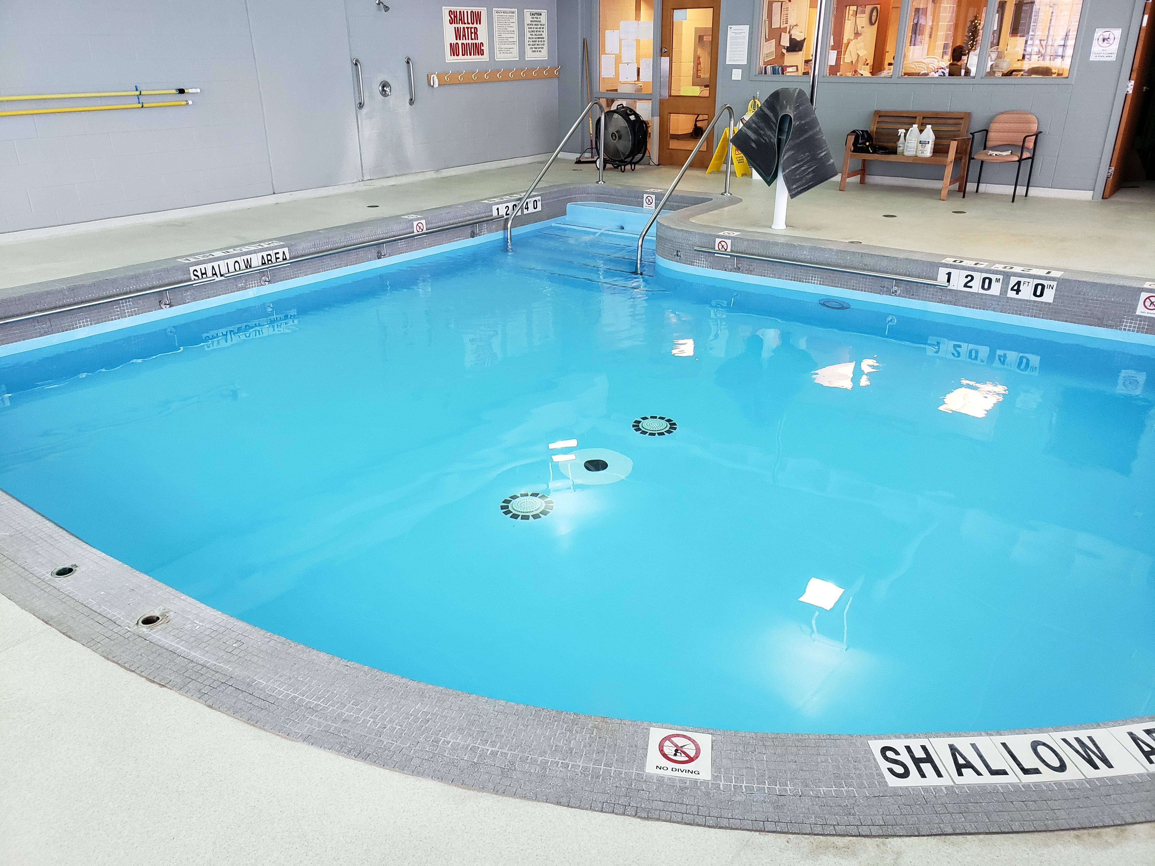
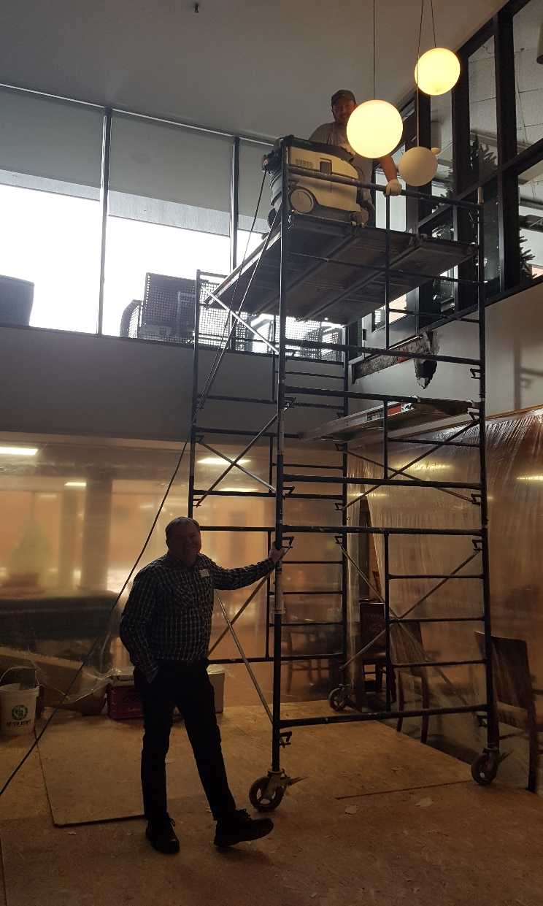
Manage resources to ensure the quality of life enjoyed today is preserved and capacity is built for those who require care and services in the future.
Sustainability
Environmental Developments
Significant building repairs
Improved utility savings
Negotiation of enhanced
service contracts
Notes:
Chris to present
As Brent mentioned our campuses (at the very least) required upkeep
As well, we were hearing many complaints from residents – at both campuses
As the new Director of Building I really appreciated the opportunity to move forward with repairs
A few significant repairs were (Chris to identify these – a few that I think of are) – Villa and Garden Home roofs, windows with seal broken, bricking, roof leaks, lights at the courts, and awnings (Parkwood) etc.
There head been some significant energy saving investments which were paying off – we continued to invest in additional (for example, lighting assessments)
Also have been focusing on negotiating cost savings and service efficiencies (spending wisely) when our service contracts come up for review i.e. purchasing group, garbage and small things like matts

Slide 8
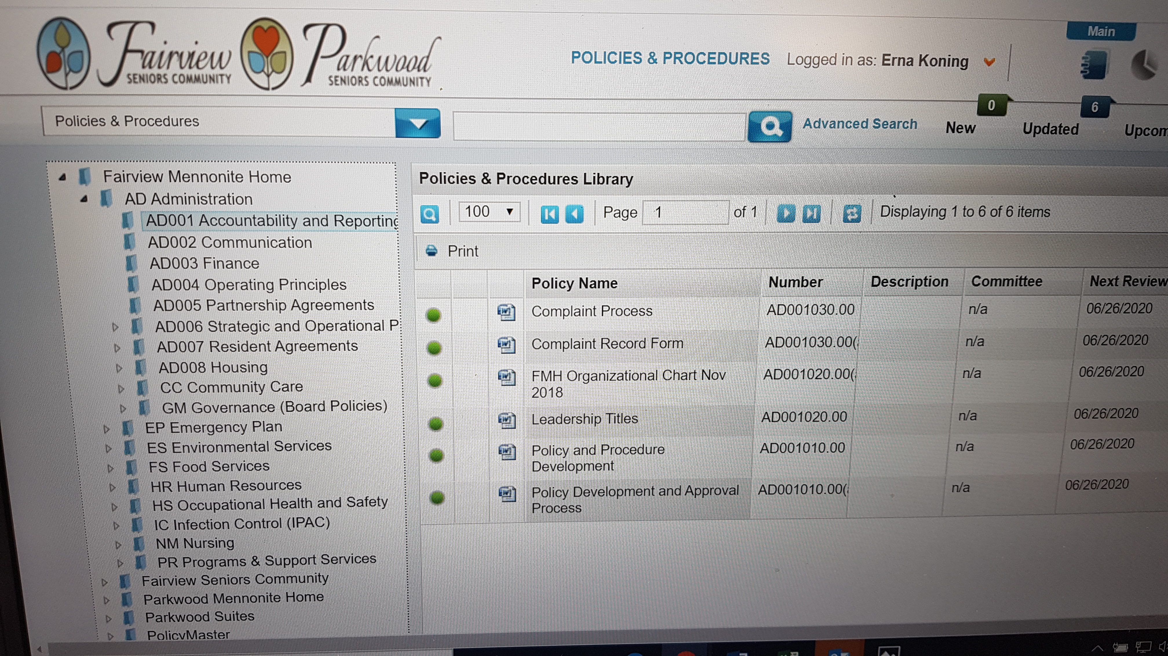
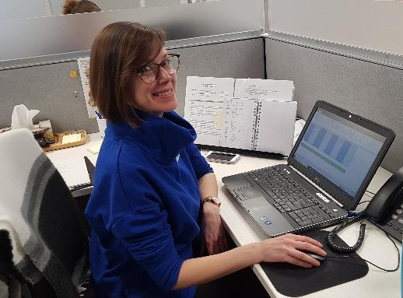
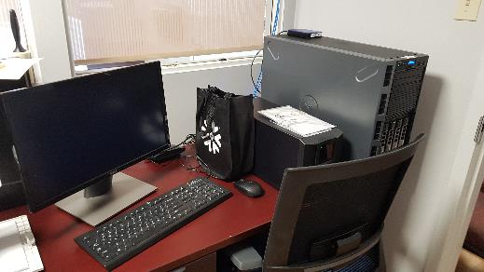
Manage resources to ensure the quality of life enjoyed today is preserved and capacity is built for those who require care and services in the future.
Sustainability
Enhanced Focus on Legislative Requirements
Outstanding unmet criteria resolved
Enhanced Policies and Procedures
Policy and Procedure developed
Consolidated across both campuses
Enhanced Technology
Introduced solid back up system
Engagement of an IT company
Notes:
Erna to present
(Make comment that these are areas you are impressed with the work that has been completed – as a new team member coming on)
The campuses – Lis and Steve – as well as the Shared Services team focused on legislative requirements
After a “not so good” Ministry RQI and Critical Incident review – a bit of a wake up call – the entire team focused on meeting legislative requirements – taking on a positive attitude to compliance – as it is the world in which we live (Accomplishment – both Fairview and Parkwood started 2020 in compliance)
This combined with rewriting policies and procedures - consolidated across both campuses
Very pleased to say – that while we will never be perfect – this legislation and solid policies and procedures require ongoing focus – for this moment we have resolved outstanding unmet criteria
A big thank you to Steve and Lis and their teams – this is a huge accomplishment
Additionally – there was a need to enhance our technology focus – after a cyber attack – we introduced a solid back up system, engaged expertise in an IT company – also added our own IT person.

Slide 9
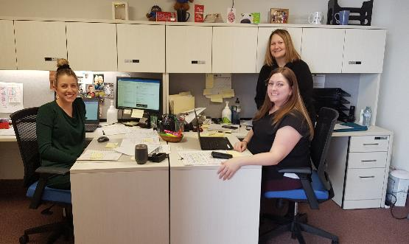
Embrace growth through talent development, cutting edge sustainable systems, clinical programs and service to the community.
Innovation
Home and Community
IALP
1,100 of visits per week
No missed visits since
initiating program
Notes:
Christine to present (Christine you can develop what you want to say)
This is so exciting for us – a new program that really compliments and completes our campus
Opportunity to embark on this journey has developed partnerships with the hospital and community; relationships are growing
Value of the team that has been established; their commitment allowed program to hire 30 PSW in an environment where it is so difficult to find PSW staff
IALP team – demonstrates the success of succession
Although program is new, it is an extension of the services provided – opportunities for growth moving forward

Slide 10
Embrace growth through talent development, cutting edge sustainable systems, clinical programs and service to the community.
Innovation
Francophone Project
Integral part of Working Group to develop
a model of Long-Term Care for Francophones
Model can be utilized for
other cultural and linguistic minority groups
Notes:
Christine to present (you can develop this – stick to what has been accomplished – a later slide talks about what we are working on)
Privileged to be selected by WW LHIN to take on initiative
Partners felt comfortable with Fairview from the onset
Launch on Friday, January 17th – we hope you can join us
Good for other minority groups – perhaps – a guide to serve our Mennonite communities

Slide 11
Develop a model of two-way communication to connect all stakeholders with honesty and transparency ensuring every voice is heard.
Communication
Utilizing Technology
Introduction of iTacit as a communication tool for Fairview, Parkwood and Shared Services
Introduction of handheld devices for front line team members for charting
Introduction of a new bulk television service (F)
Notes:
Brent to present. (Brent you can develop this)
Bringing on board IT technician has been invaluable in supporting IT technology and relieving the CFO of major time commitment
New servers at each location in the past year as well as significant planned replacement of PC stock (process started in 2019, and will be continue in 2020)
Upgraded wi-fi networks in each locations, better support the use of technology in each location
Upgraded technology has created efficiencies for teams
IT technician – as part of team – had a huge impact

Slide 12
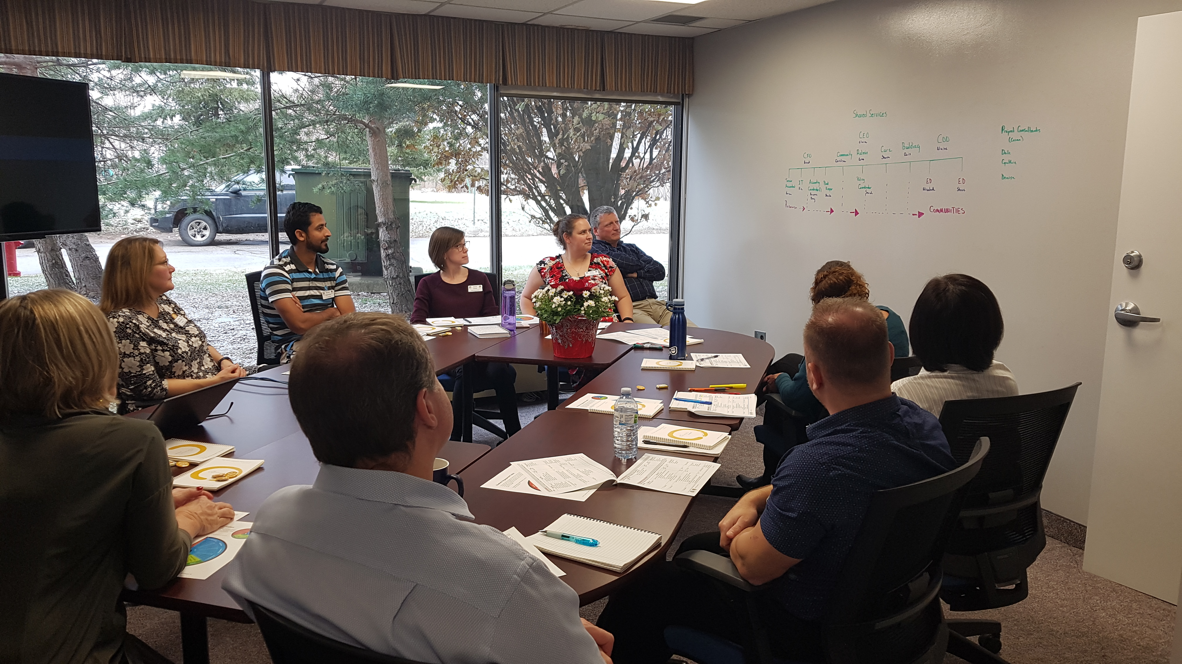
Develop a model of two-way communication to connect all stakeholders with honesty and transparency ensuring every voice is heard.
Communication
Collaboration Between Homes
Introduction of new meeting structure has
direct impact on decision making
Meetings include:
Shared Services Meetings
Executive Directors with Shared Services Meetings
Directors of Care Meetings
Financial and Operational Review Meetings
Notes:
Chris would you be willing to present this slide? I can help you add a few comments here.
Chris comments
I (Chris have not been the person who put in place this structure, I am part of the team)
We have trialled a few different ways of meeting – in order to promote collaboration between the homes
This has included leadership development days, training of Kindness mentors, health and wellness challenges
We have also added a more formalized meeting structure – (read slide)
While still in the early stages – we are having good discussions with everyone committed to bring consistency across the organization.

Slide 13
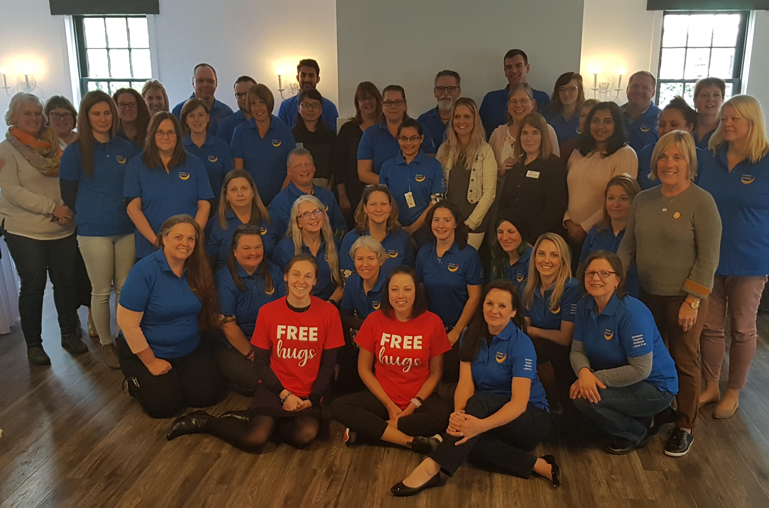
Develop a culture of kindness through internal and external interactions, nurturing mind, body and spirit.
Relationships
Kindness Initiative
Training of 20
Certified Kindness Champions
Kindness focus of
Homes’ Operational Plan 2020
Notes:
Erna to present
A few things to include in comments
Initiatives – Christmas trees - Advent Calendar (might include card that resident made,) – neat ideas embraced (environmental bags) mentors wearing shirts
While we are just beginning to delve into this initiative – we are embracing across the organization
Resident engagement (Christmas cards for grandchildren, telling them to be kind)
Focus of Operations plan (has specific objectives) – Fairview, Parkview and Shared Services
Initiative to bring all teams together – Walking the Kindness Way – trek

Slide 14
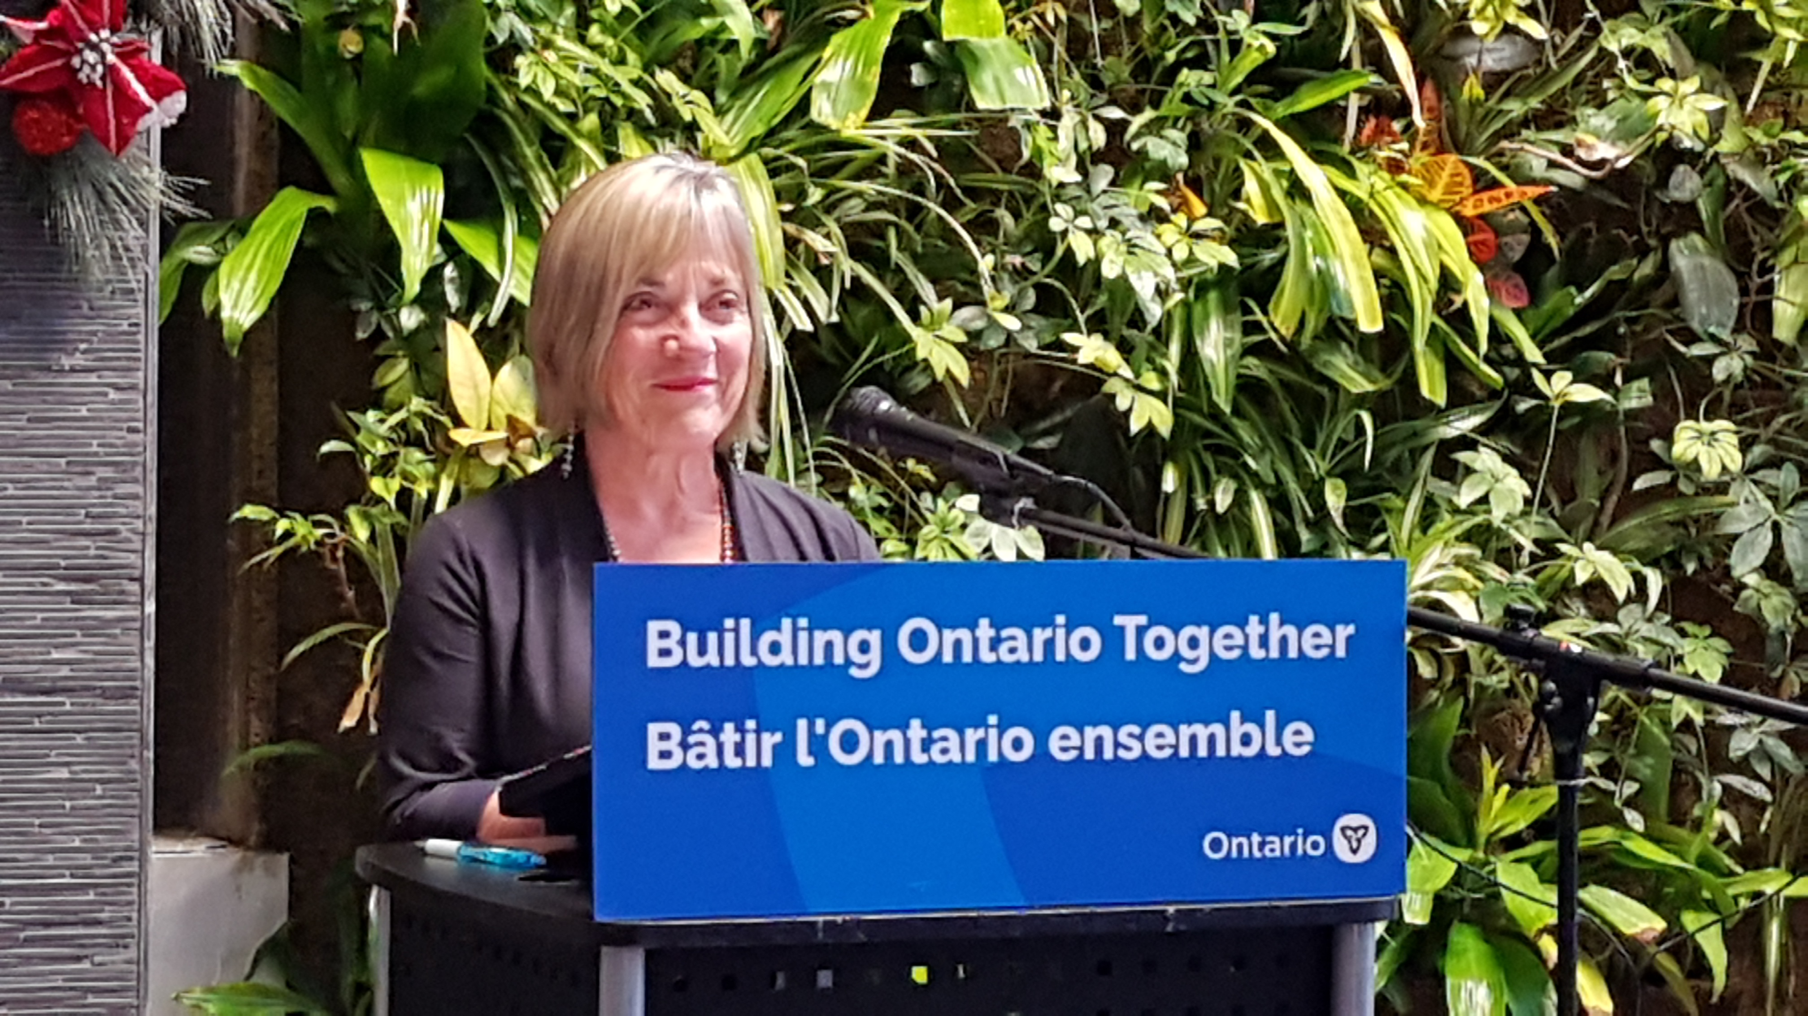
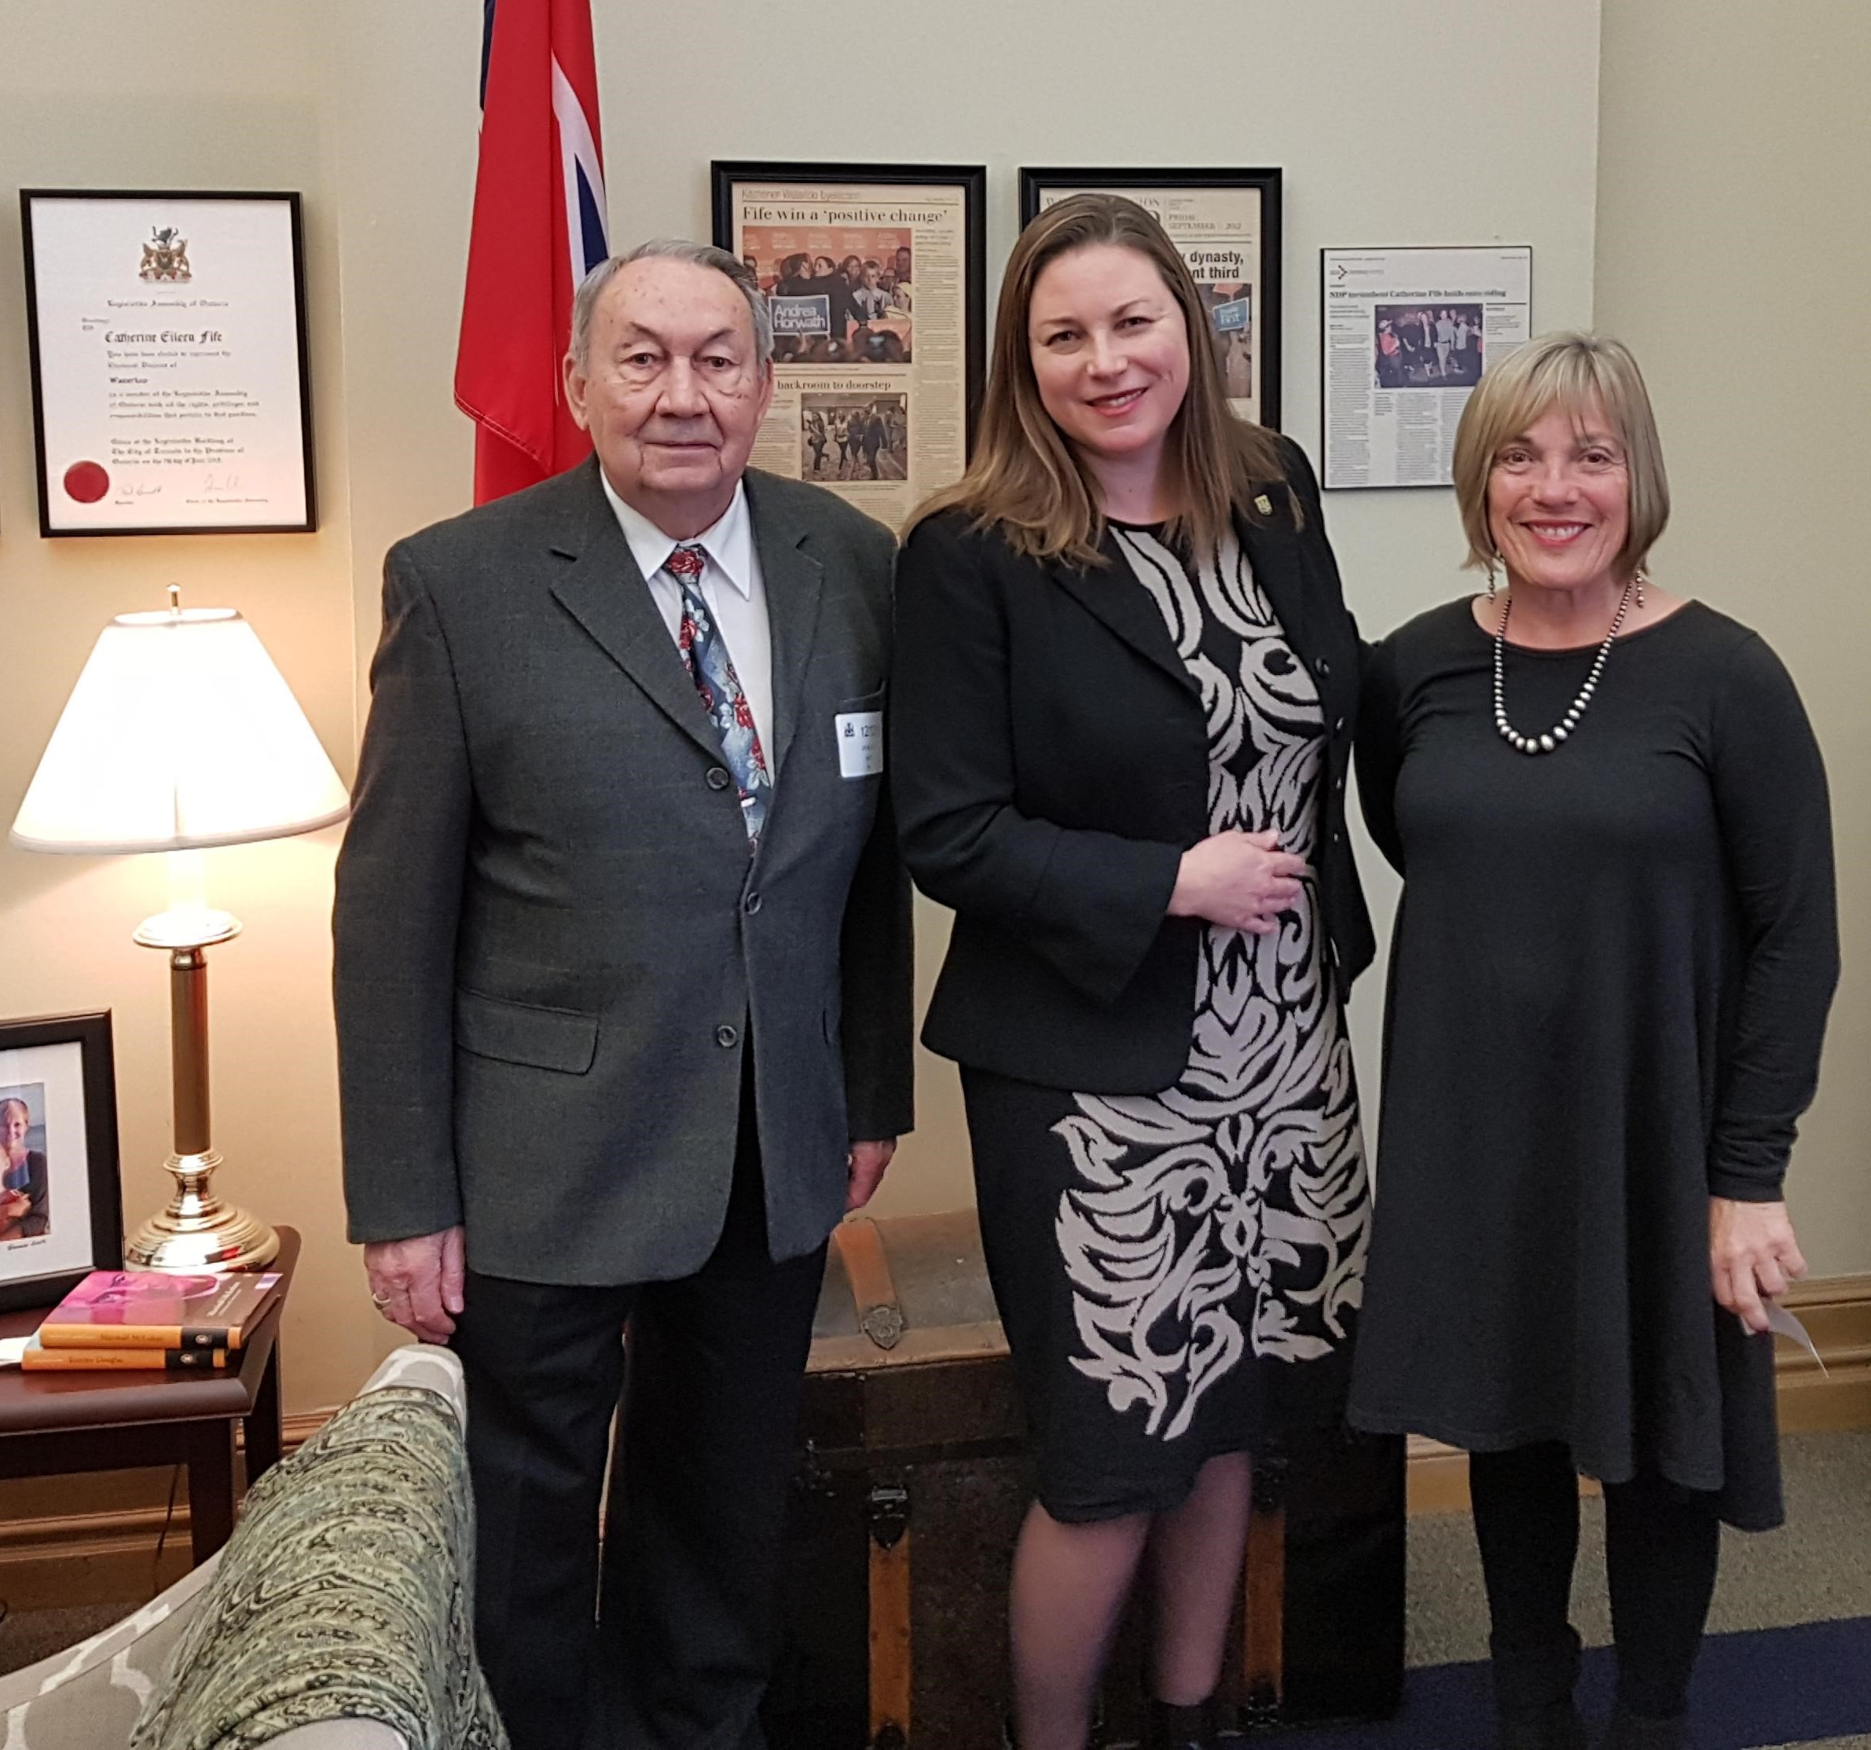
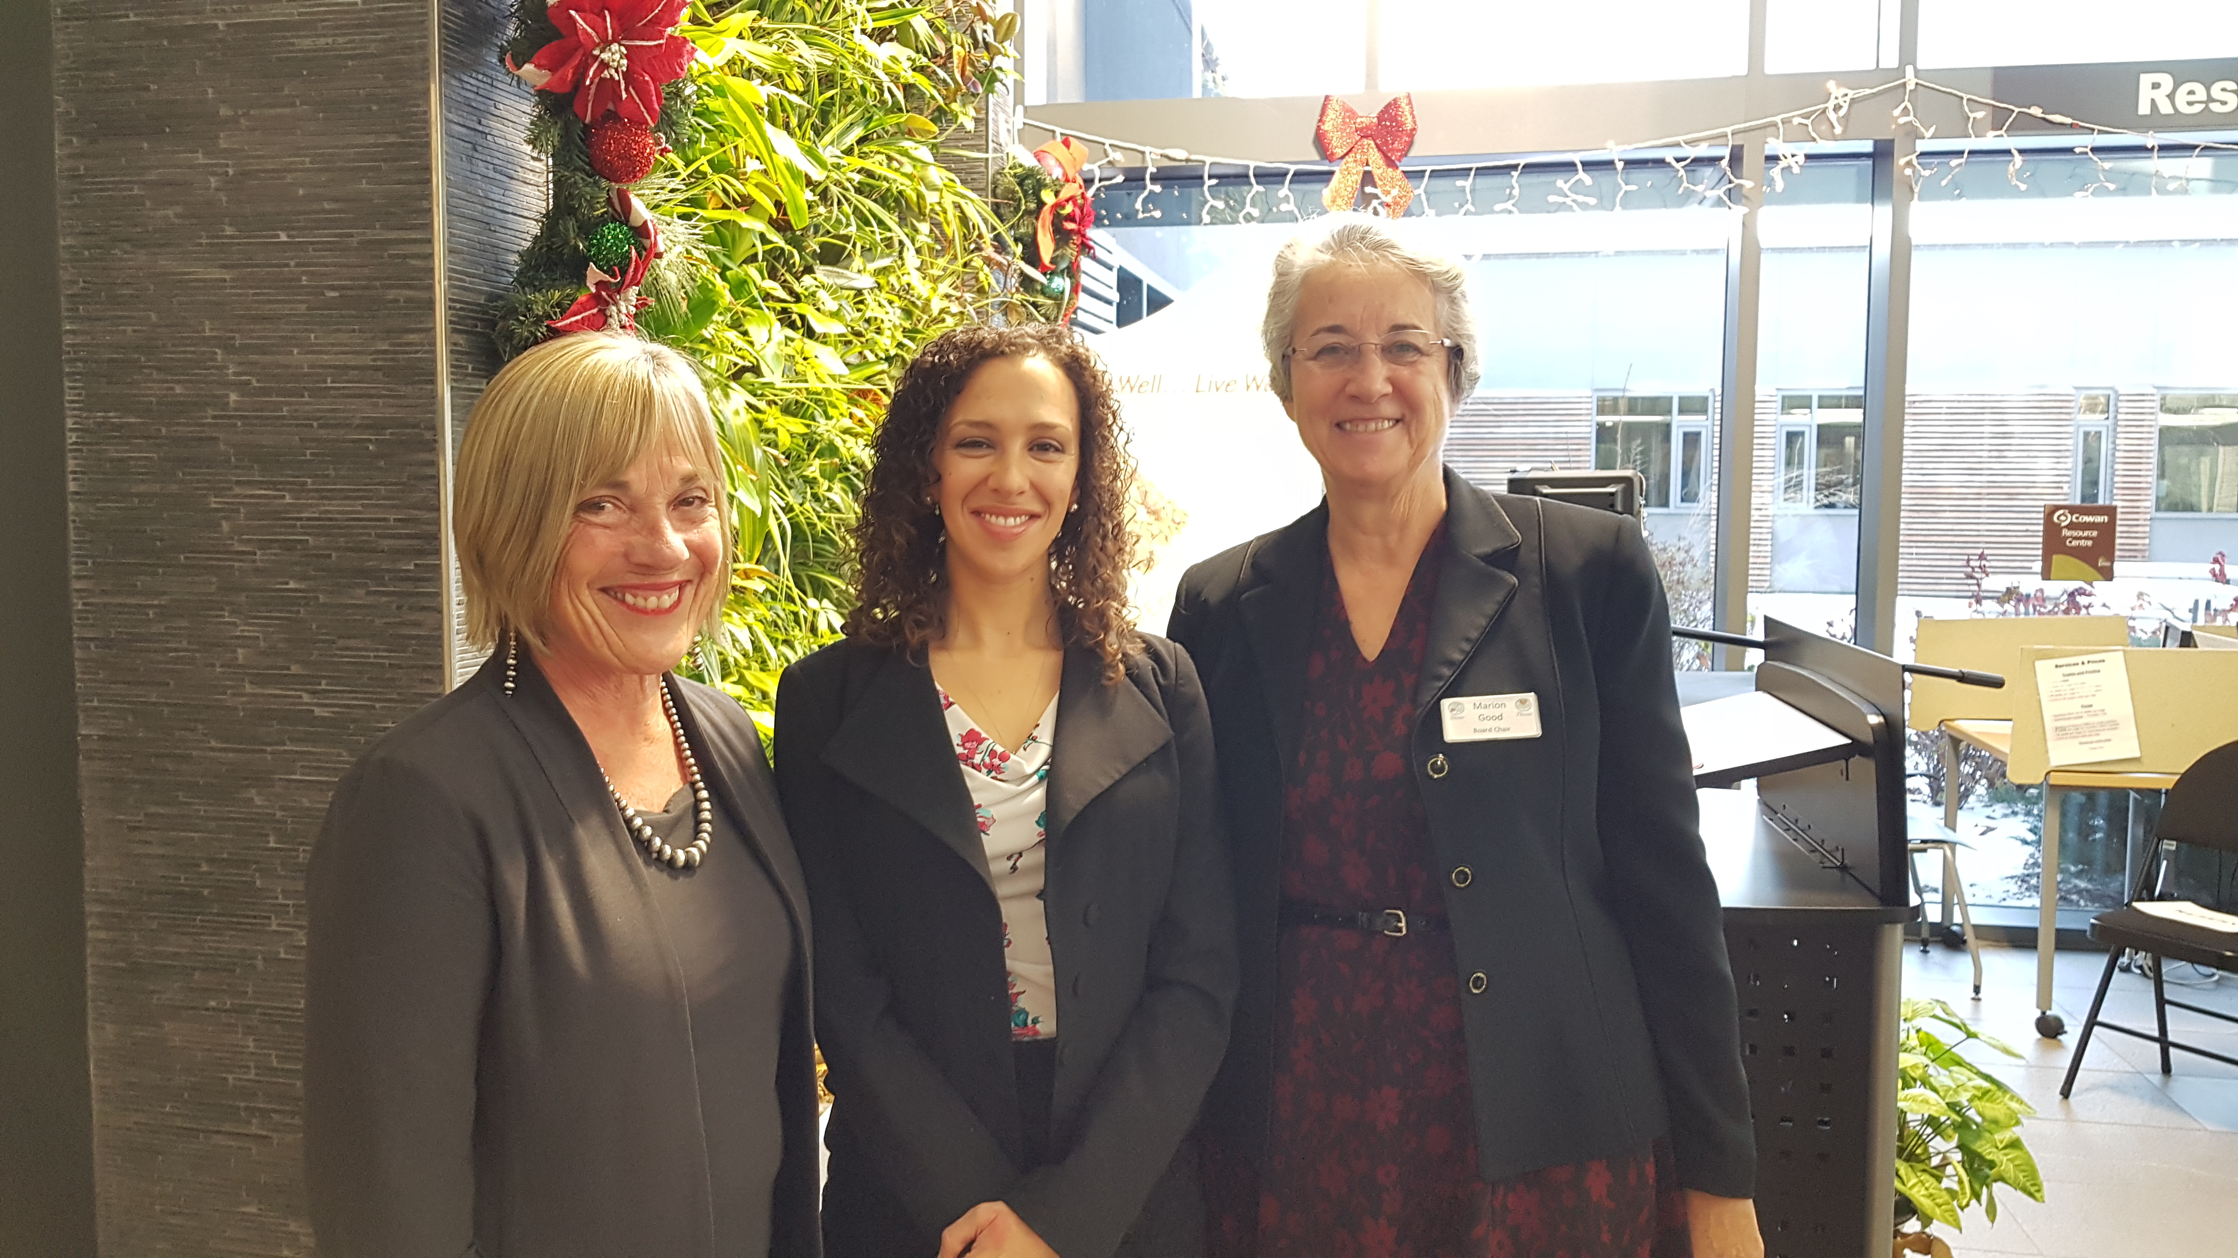
Develop a culture of kindness through internal and external interactions, nurturing mind, body and spirit.
Relationships
Presence in Sector
Ontario Health Team
Attend conferences
Functions
“Till Death Do Us Part” Bill
Notes:
Elaine to present

Slide 15
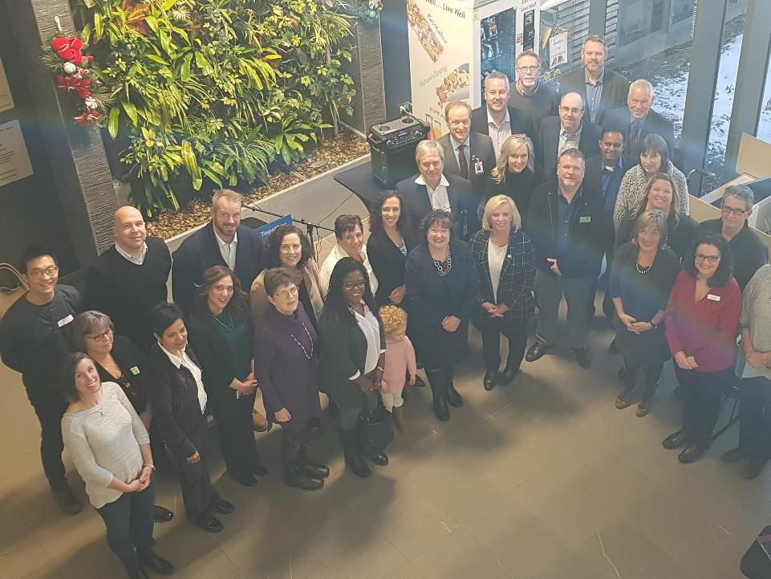
Notes:
Elaine to present

Slide 16
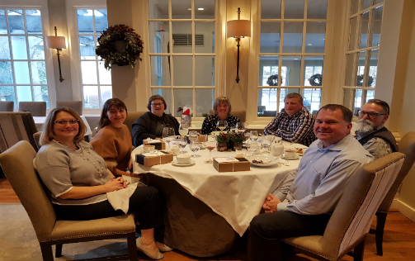
Shared Services Team
Act as a resource to campuses:
Finance
Community Development
Building Services
Administration
On Site Technology Support
Human Resources Practices
Left to right Christine Normandeau, Director Community Development,
Erna Koning, Director Administration, Elisabeth Piccinin, Executive Director,
Elaine Shantz, Chief Executive Officer, Brent Martin, Chief Financial Officer,
Steve Pawelko, Executive Director, Chris Brissette, Director Building
Notes:
Elaine to present

Slide 17
Define and develop a faith-based platform, setting the organization
apart, using the solid foundation on which it was built,
which will take Fairview and Parkwood into the future.
Spirituality
Accomplishments
Director of Spiritual Care and Culture
Welcome Statement
Notes:
Christine to present
To include: Community involvement in developing welcome statement and hiring process
Participation of broader Fairview and Parkwood community

Slide 18
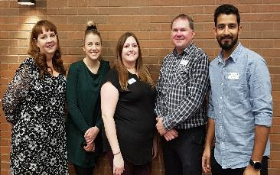
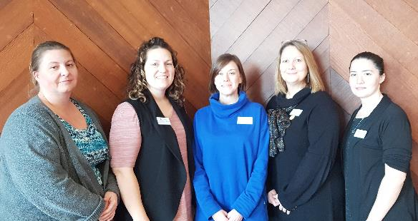
What We Are Working On
Developing Leaders/Succession Planning
Honouring our faith-based roots while
enhancing the culture for the future
Refurbishing Campuses
Enhanced IALP
Implementation of Francophone Project
Development of Demonstration Project
Notes:
This will be a shared slide:
Bullet 1 – Elaine
Bullet 2 – Christine
Bullet 3 – Chris (before entering into new projects)
Bullet 4 – Christine
Bullet 5 – Christine
Bullet 6 – Elaine

Slide 19
What We Are Working On
Enhanced Community Relations (KW4)
Development Living Classroom
Enhanced Technology and implement last phase of NAV software
Locating Offsite Office for Shared Services
Notes:
Shared presentation
Bullet 1 – Elaine
Bullet 2 – Erna – discussion with St. Louise school; exploring initiative
Bullet 3 – Brent
Bullet 4 – Brent

Slide 20
Dreams
Fairview Services Community
Long-Term Care Bed Application (F)
Parkwood Services Community
Affordable Housing (P)
Notes:
Elaine to present

Slide 21
Leadership is a Journey – Walking Together
There
Relieve Poverty
Innovation
Work Smart
Efficiency
Spend Wisely
Mission
Engaged Employees
Outstanding Customer Service
Affordable Cost
Vision
Building a Community for ALL
Be Kind
Communicate with Compassion
We are
Here
Embracing Change
Notes:
Elaine to present

Slide 22
Poverty
What does “relieving poverty” for the frail and elderly mean today?
What is Fairview and Parkwood’s “reason for being” in the future?
Why should Fairview and Parkwood embrace growth opportunities?
What will our story be 5 years from now – 10 years from now?
Notes:
Elaine to present

Slide 23
1 @ $1,000,000
2 @ $500,000
8 @ $125,000
4 @ $250,000
Notes:
Slide is for later morning

Slide 24
Notes:
Elaine to present

Slide 25
Fairview Seniors Community
Fairview Mennonite Homes
Parkwood Seniors Community
Parkwood Mennonite Home
Notes:
Elaine to present

